Slide 1
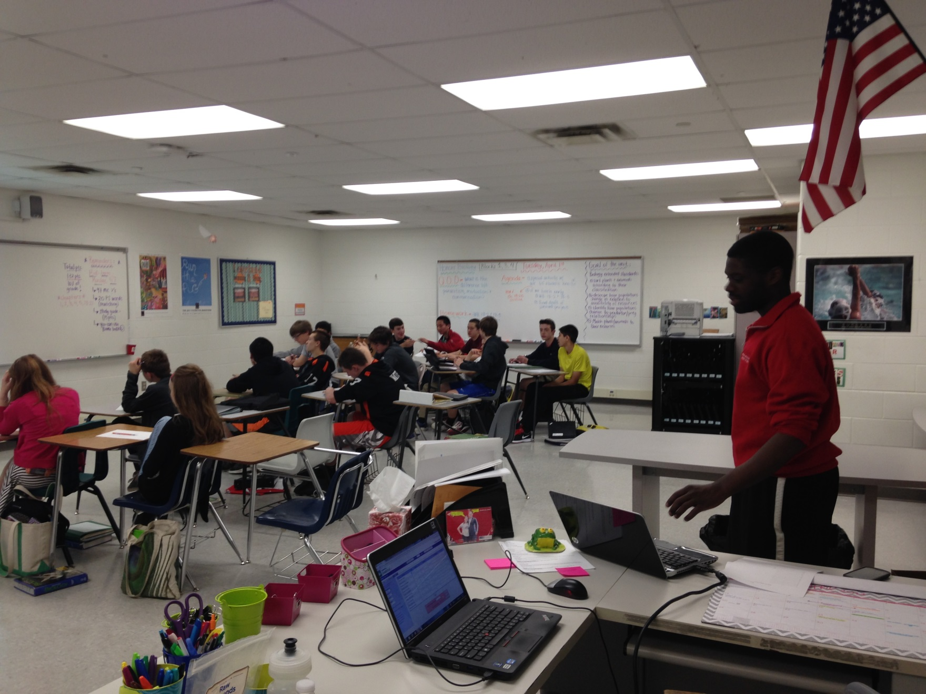
Materials Selection of a Medical Device Kenechukwu Okoye Loveland HS, Biology
RET is funded by the National Science Foundation, grant # EEC 0808696.
Unit Overview
Unit Activity Implementation
Student Work
Topic:
Materials Selection in Medical Devices
Standards:
Medical Technology
Day One
Administer Pre-test
Present Hook
Deliver lecture
Present challenge
Assign groups / devices
Students work on Challenge
Day Two
Continue Working on Challenge/ presentations
Groups present findings
Administer Post-test
.
Please summarize assessment results (graphically if possible)
Assessment Results:
Impact on Student Learning
Activity Structure
Title: Materials Selection of a Medical Device
Guiding Questions:
How do you select the type of material to go into a medical device?
Objectives:
Identify Material Properties and how they meet device needs.
Engineering Design Process
This activity focuses specifically on a vary important part of the medical device engineering design process, taking the properties of available materials, weighing them against one another and making a selection.
Application: The type of thought process directly affects the outcome of patients that use/require these devices
Career Awareness: This activity explores the tasks of a biomedical engineer. The lecture makes students aware of the consequences for engineering
Societal Impact: Overall materials selection of medical devices improves healthcare and improves quality of life
Reflection and Conclusion
Having done the activity, I would have broken up the activity worksheets into more steps to guide their thought processes. I maybe would have found additional resources to which to direct them.

